Slide 1
Optimizing price strategy for AIRBNB listings
By Anna Domas

Slide 2
A BRIEF INTRODUCTION
Name: Anna Domas
Education: Master degree in Safety industrial Engineering (BMSTU );
More than 10 years of experience in certification of industrial dangerous facilities;
Entry level data analyst;
Graduate student WGU majoring in Data Analytic program;
Graduated from Yandex Practicum in Data Analyst Professional Training Course;

Slide 3

a statement of the problem and the hypothesis
Research question: to what extent do review scores, location, day, and room type affect price?
Null hypothesis Ho: review scores, location, day, and room type statistically significantly do not affect pricing
Ho=Ho1+Ho2+Ho3+Ho4 Alternate Hypothesis Ha: review scores, location, day, and room type statistically significantly affect pricing
Ha=Ha1+Ha2+Ha3+Ha4
Open source of information: insideairbnb.com

Slide 4
Area of research: Asheville, North Carolina Used datasets: listings.csv.gz, calendar.csv.gz, reviews.csv.gz
a statement of the problem and the hypothesis
Listings
id
name
calendar
listing_id
date
review
listing_id
description
source
etc
total 75 columns
available
price
adjusted_price
minimum nights
maximum nights
id
reviewer_id
reviewer_name
comments
date

Slide 5
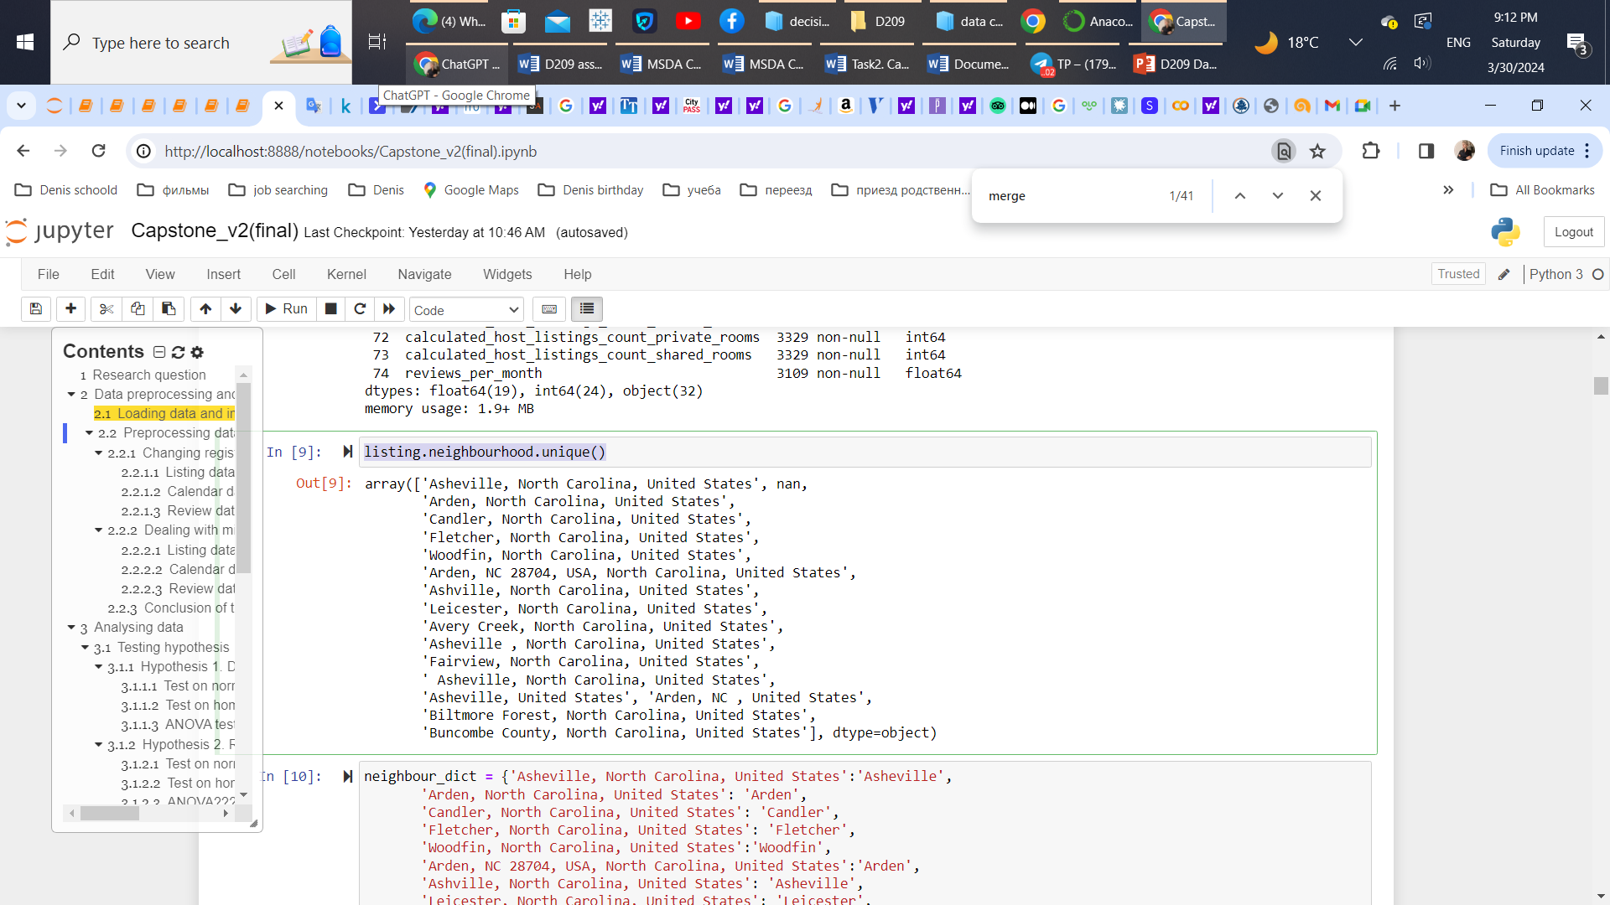
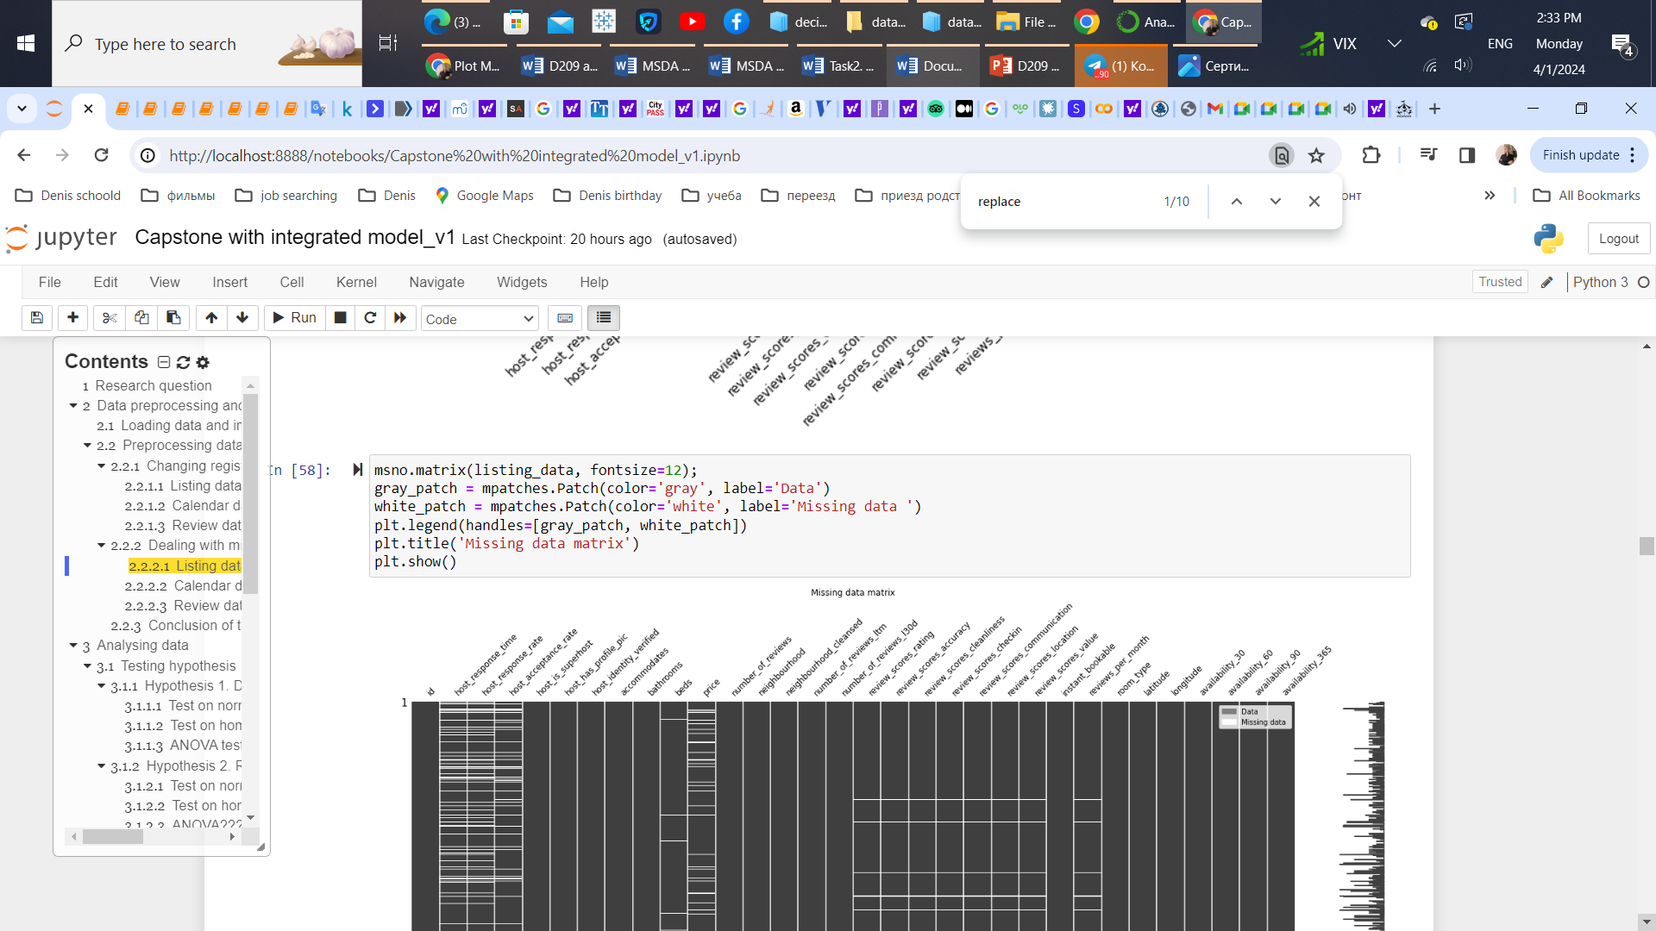
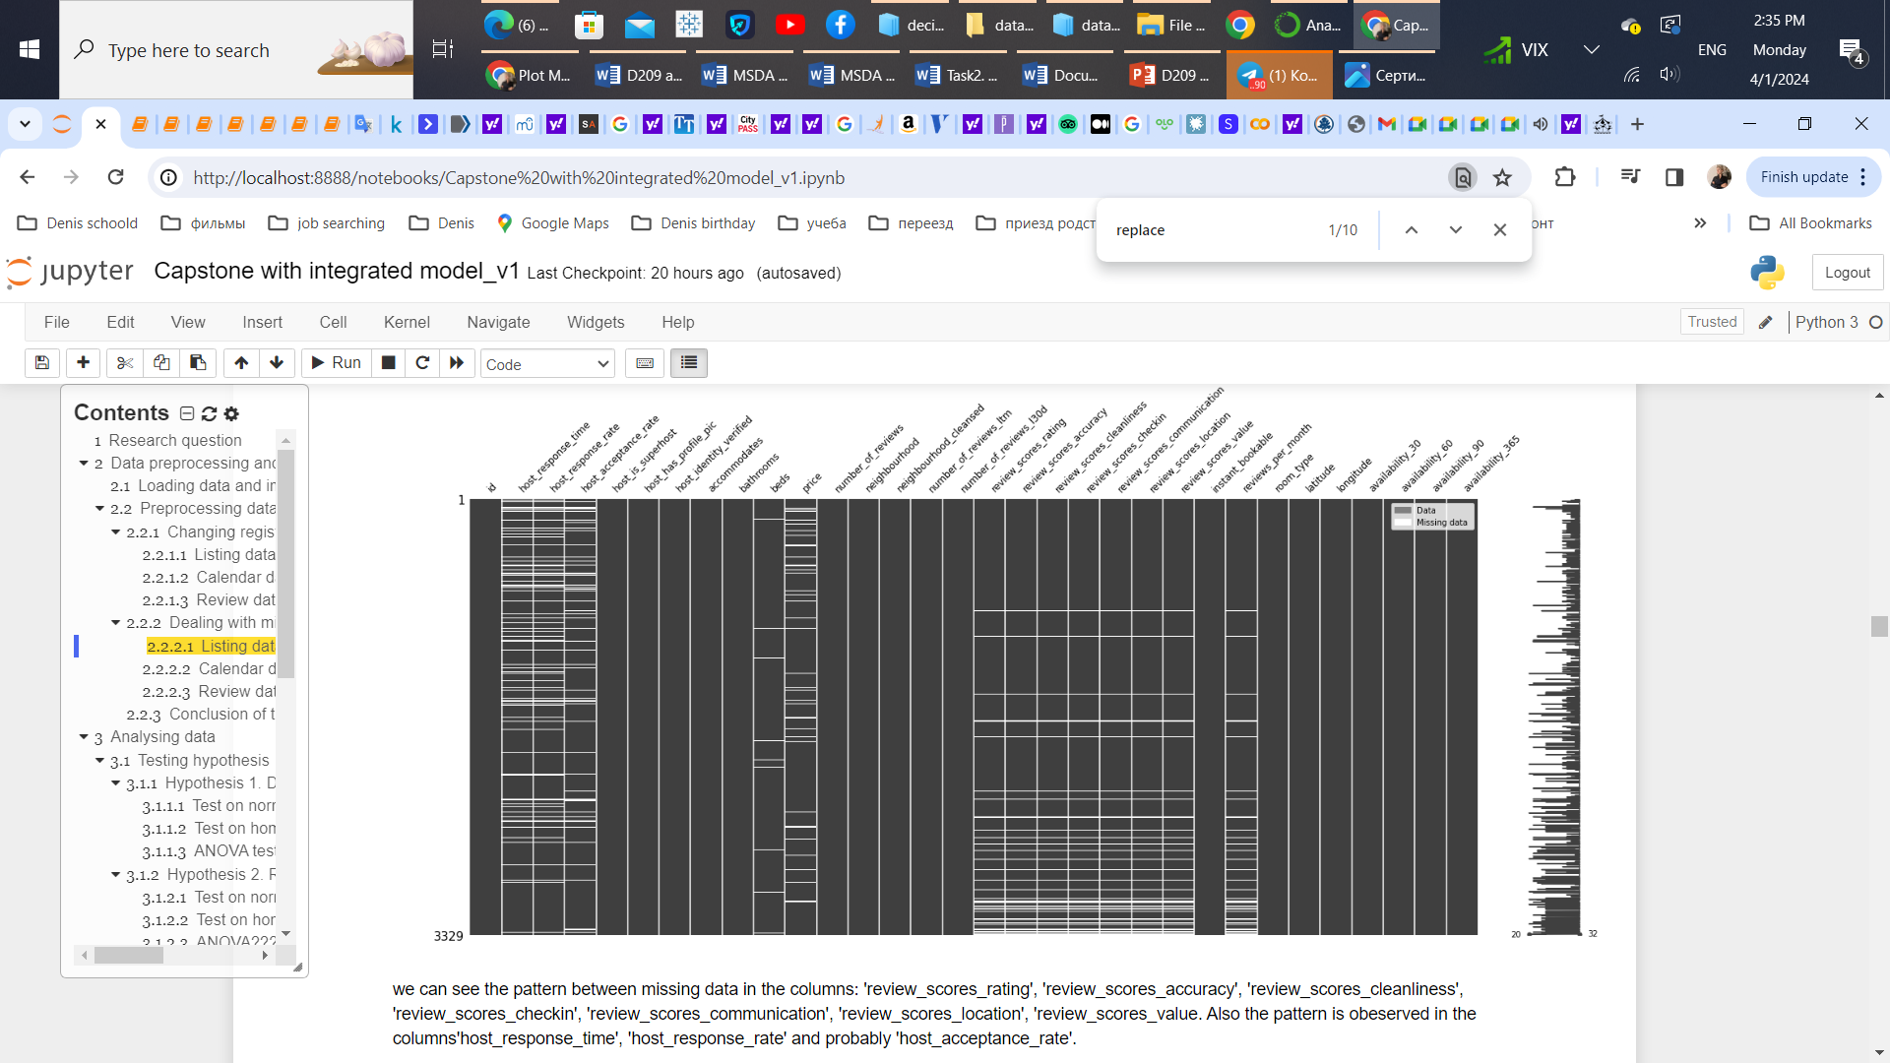
a summary of the data-analysis process. Listings dataset
Data cleaning (variations or inconsistencies due to misspellings, different capitalizations, or alternative representations)
Removing $, % symbols (regex)
Integer encoding of Boolean type
Extracting numbers from string description (bathroom column)
Dealing with missing data and duplicates
Imputation technique: for columns with MNAR missing data were filled by 0, or others – median values.
MNAR

Slide 6
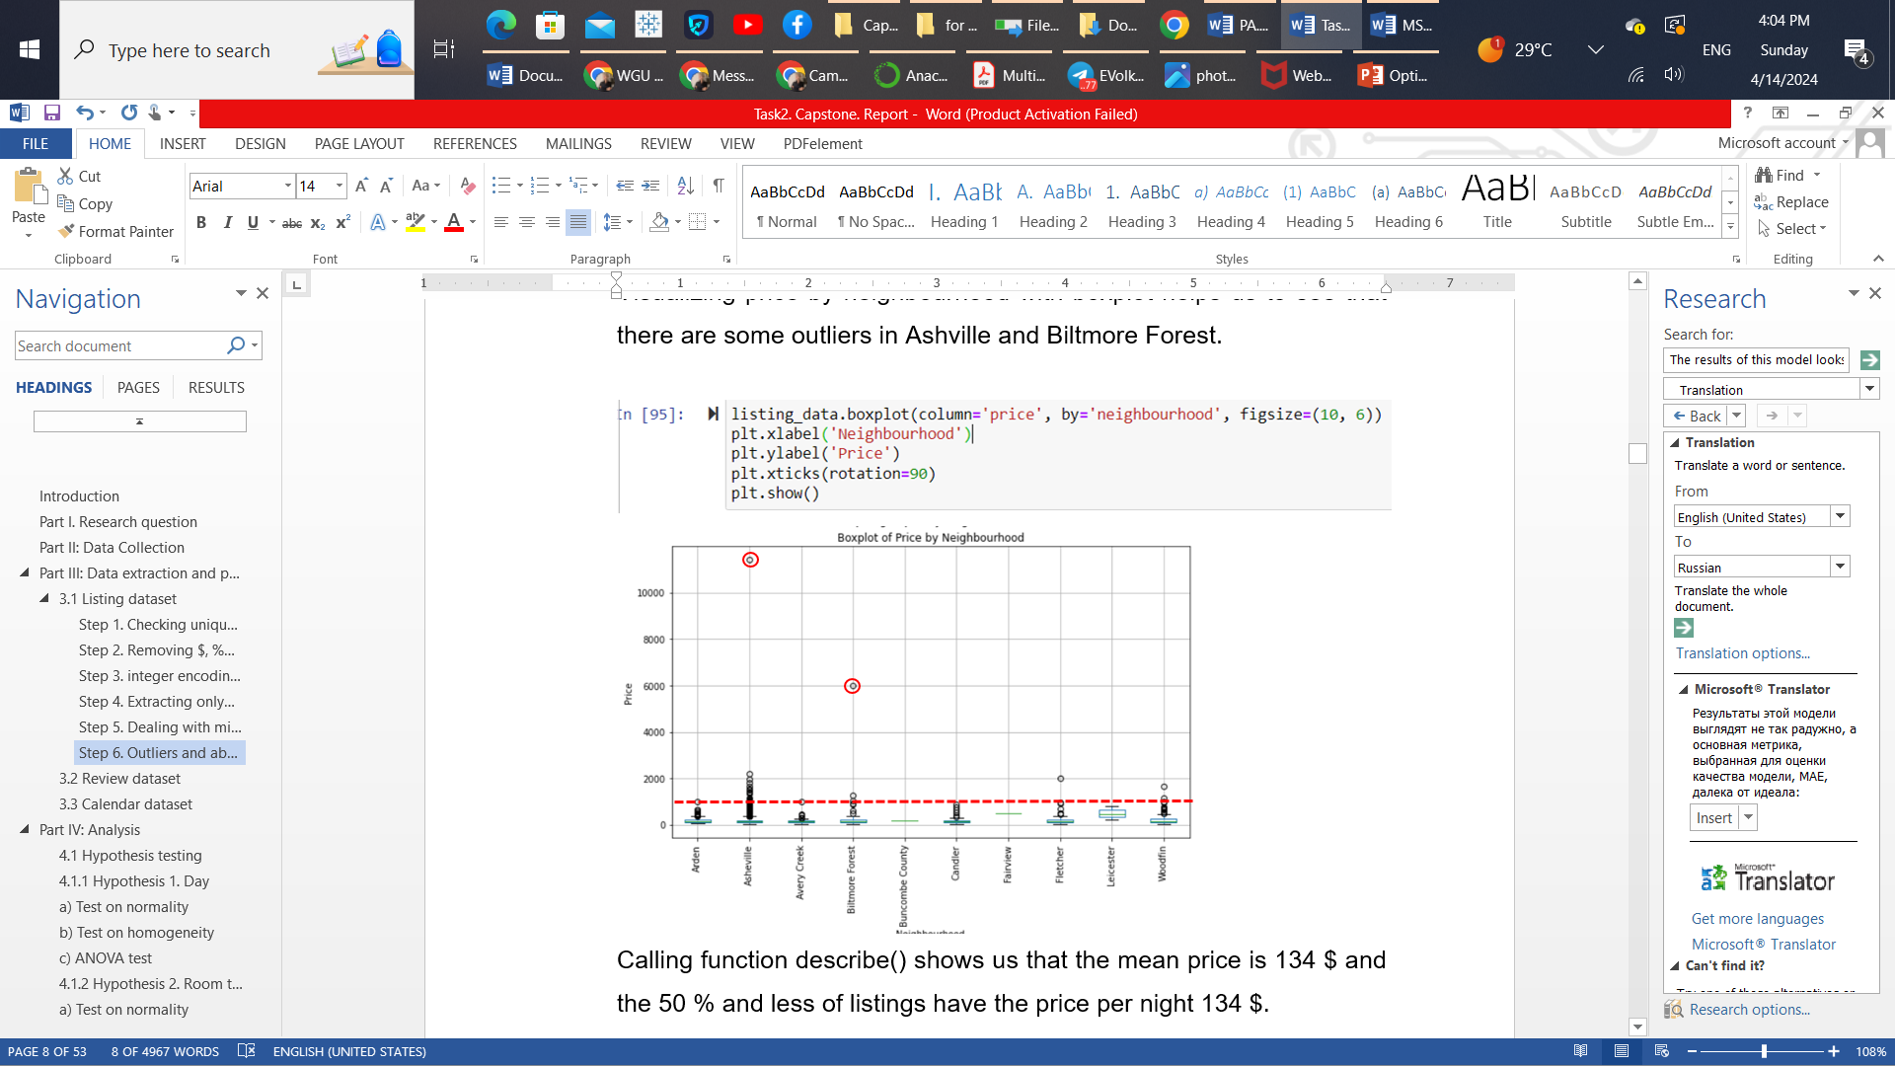
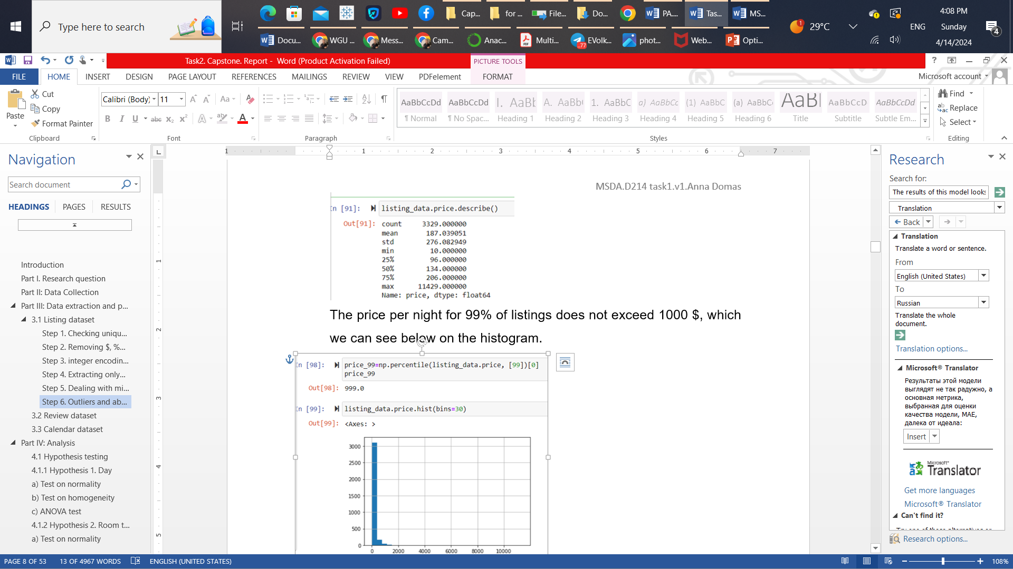
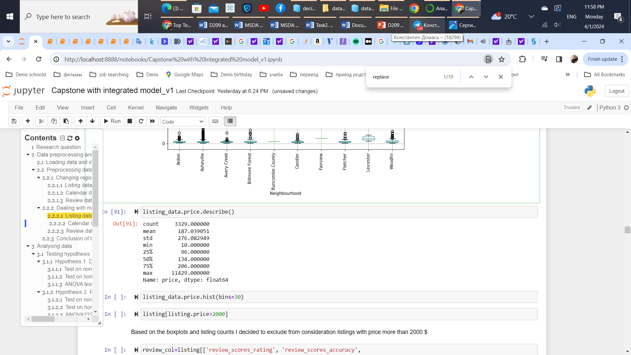
a summary of the data-analysis process. Listings dataset
Finding outliers. The price per night for 99% of listings does not exceed 1000 $
Making visualization and analyzing statistical information;
Standardization features
Transformation of the skewed data distribution to make it closer to normal distribution;
Merging datasets to include information about dynamically changing prices over the year;

Slide 7
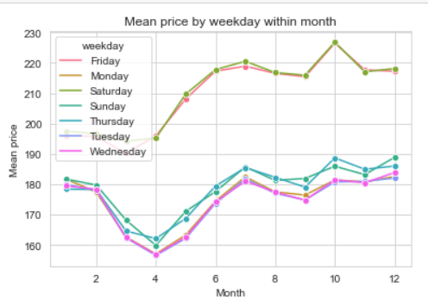
a summary of the data-analysis process. HYPOTHESIS 1
Ho1: The mean prices of any day are not significantly different.
Ha1: The mean prices of any day are significantly different.
Output:
Bookings on Tuesdays and Wednesdays generally offer
lower prices.
Prices of bookings on Friday and Saturday are highest.
Test on normality (qq plots)
Test on homogeneity (ratio =1.33<2)
ANOVA test
Booking days have a statistically significant effect on the price with the large F-statistic=122.47 and p-value = 1.6*10^-83 which is much lower than the statistical significance 0.05 level.

Slide 8
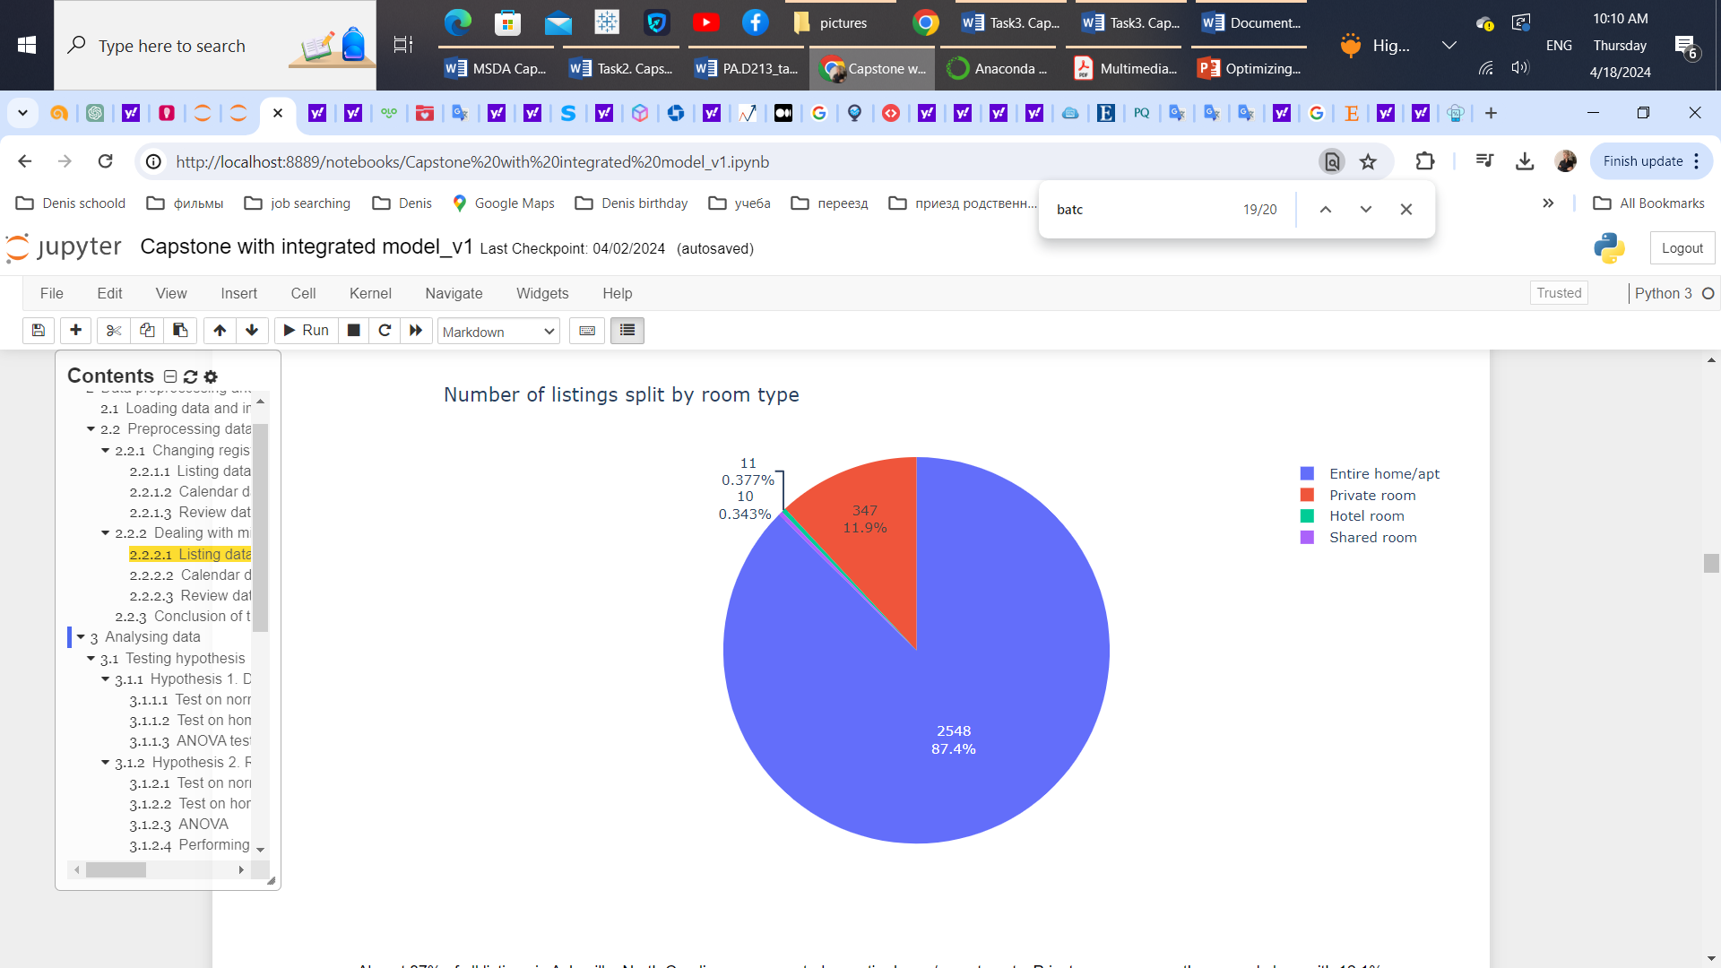
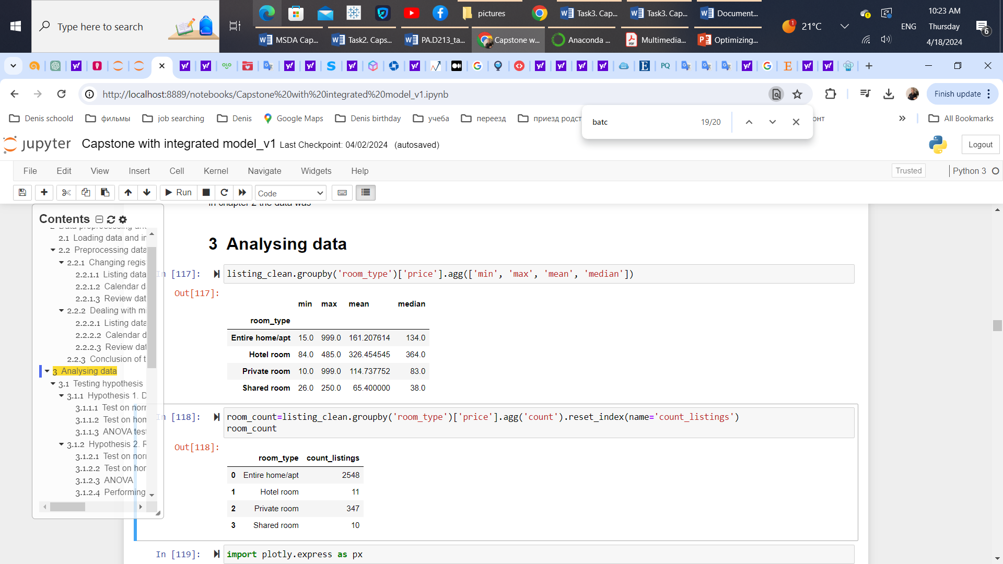
a summary of the data-analysis process. HYPOTHESIS 2
Ho2: The mean prices for different room types are not significantly different.
Ha2: The mean prices for different room types are significantly different.
Output:
There are 4 types of rental properties: Entire home/apt, private room, hotel room and shared room.
Hotel rooms and shared rooms represented a minor portion of the listings in the dataset (< 0.4%) and associated with min prices
Test on normality (shared room)
Test on homogeneity (ratio =1.14<2)
ANOVA test
Room types have a statistically significant effect on the price with the large F-statistic=6127 and p-value = 0 < significance level = 0.05.

Slide 9
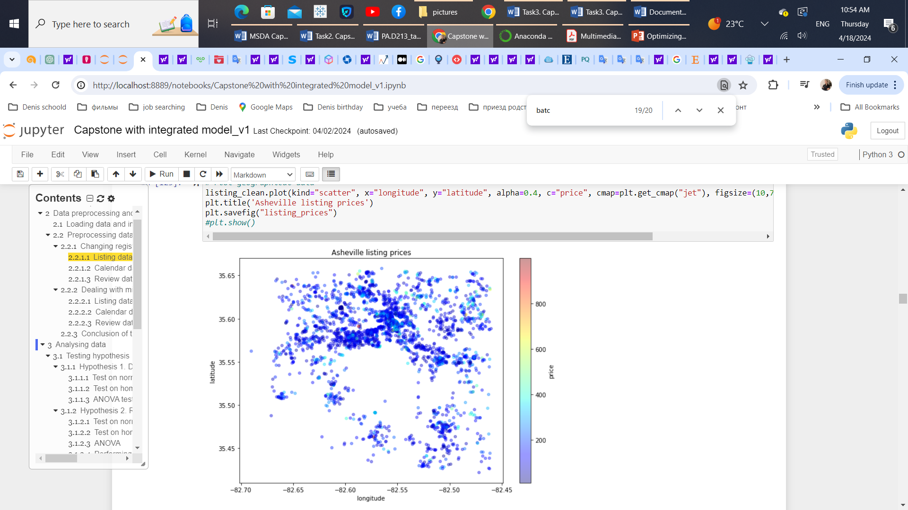
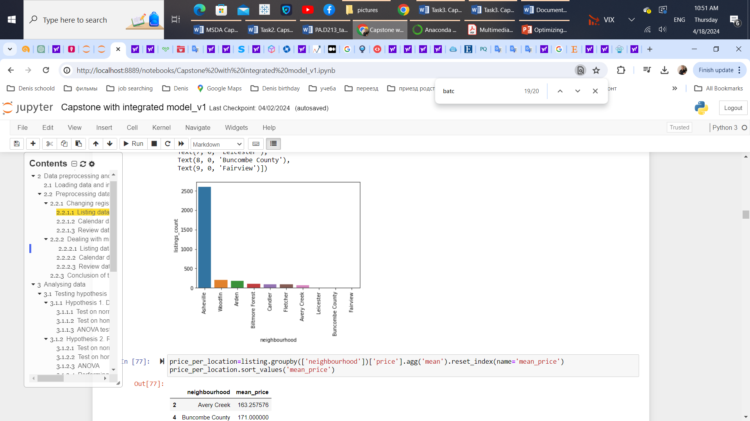
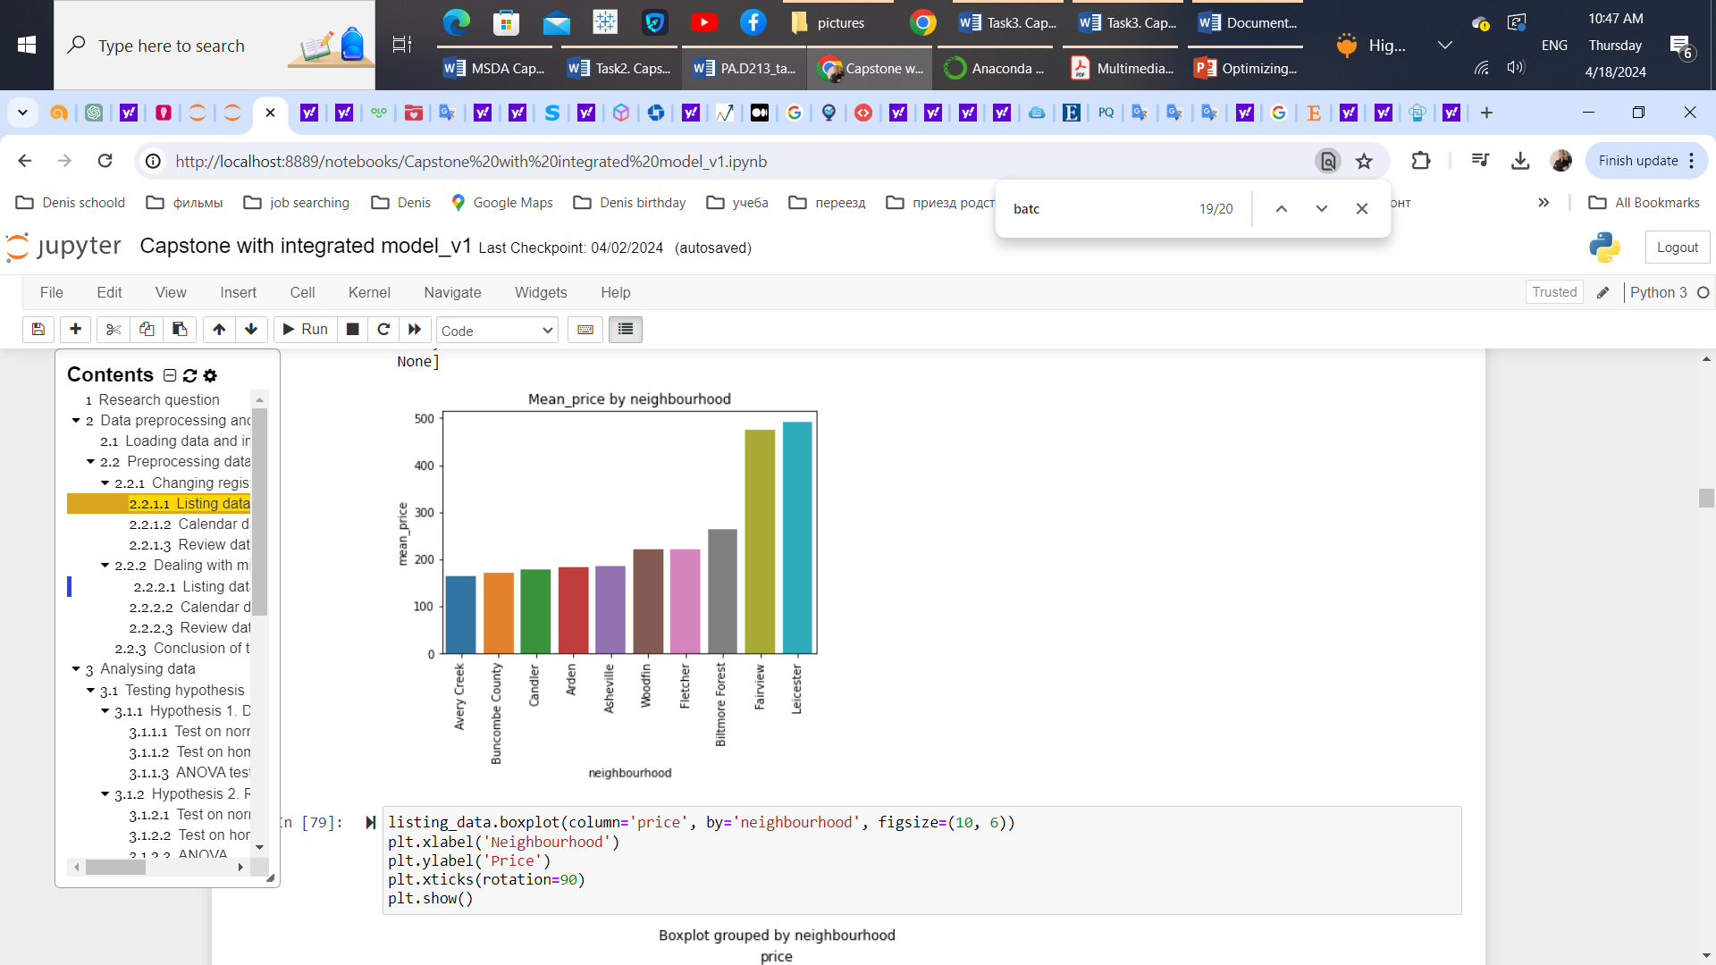
a summary of the data-analysis process. HYPOTHESIS 3
Ho3: The mean prices are not significantly different for listings in different neighborhoods.
Ha3: The mean prices are significantly different for different neighborhoods.
Output:
There are 10 neighborhoods in the dataset. The majority of listings are concentrated up north in Asheville.
3 neighborhoods: Leicester, Buncombe County and Fairview are outliers: a few listings (3,1,1 respectively) with highest mean price (were out of analysis).
Test on normality
Test on homogeneity (ratio =1.33<2)
ANOVA test
Location has a statistically significant effect on the price with the large F-statistic=425 and p-value = 0 < significance level = 0.05.

Slide 10
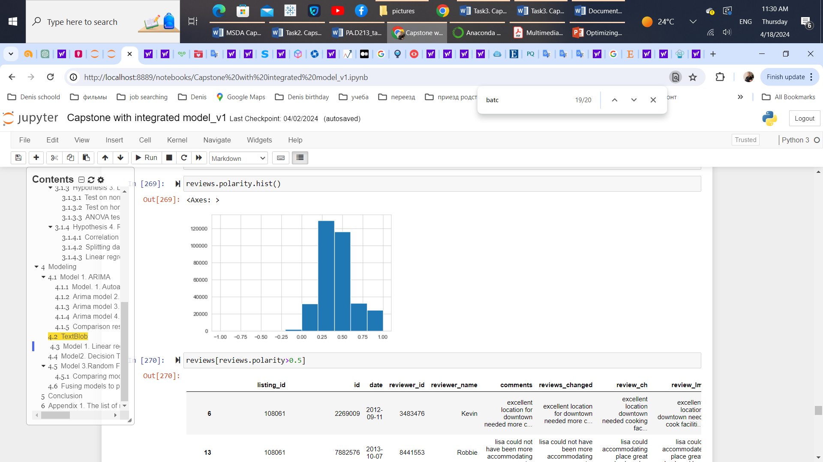
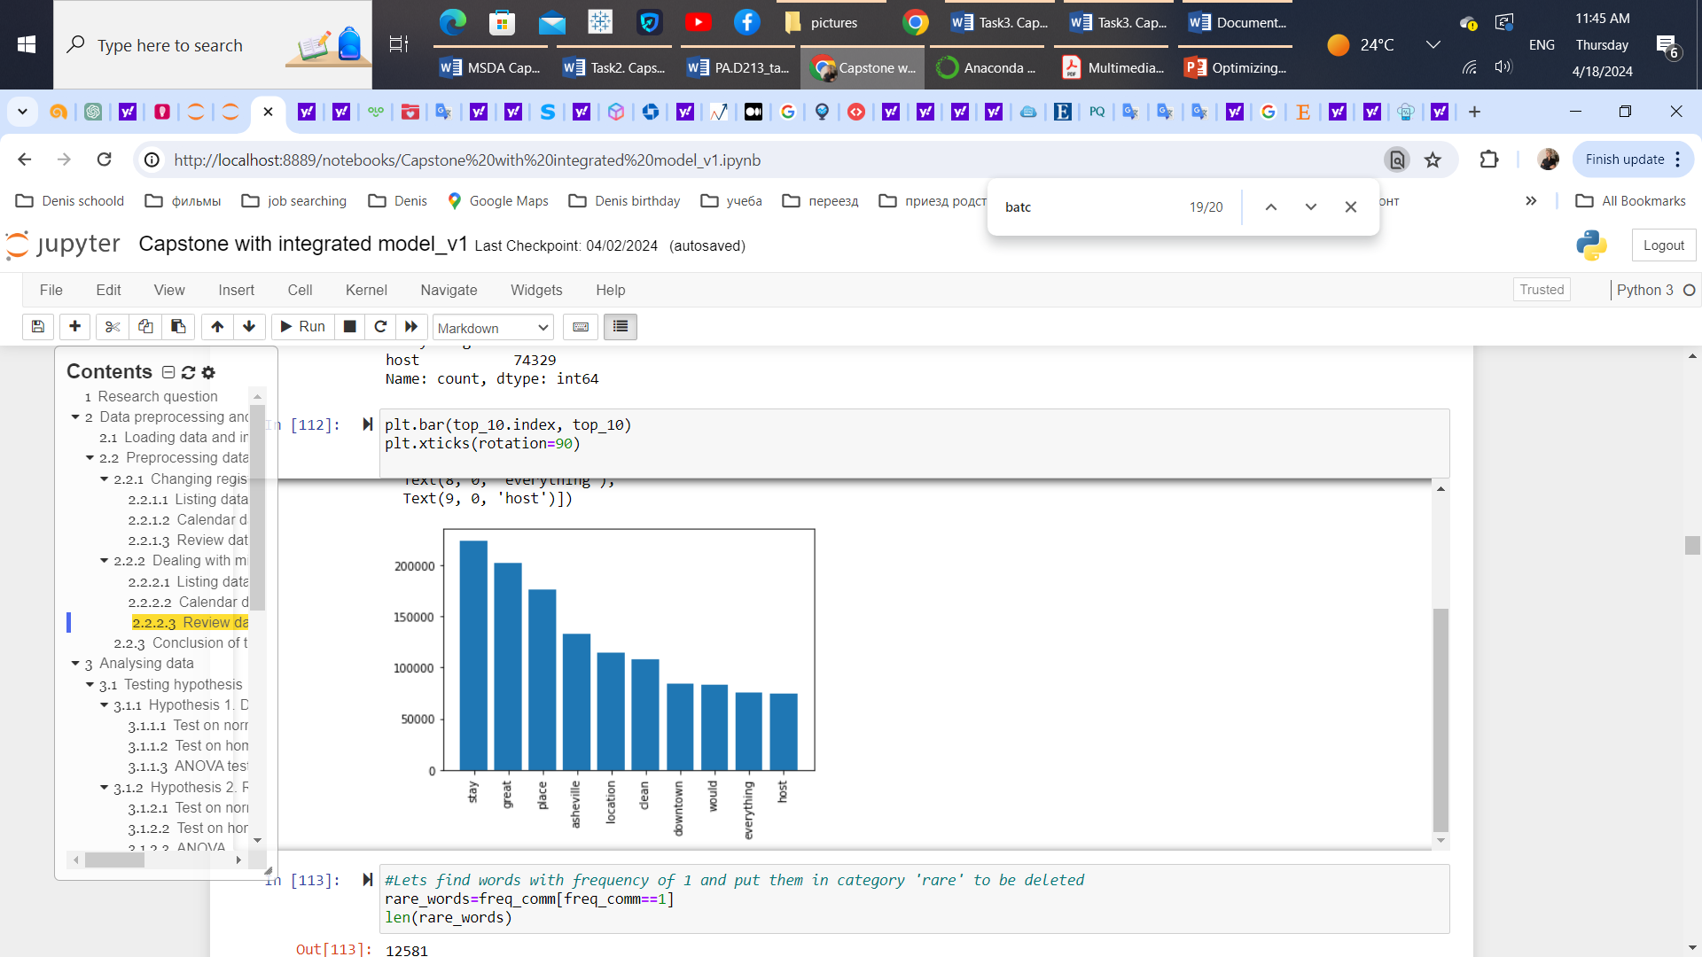
a summary of the data-analysis process. HYPOTHESIS 4
Ho4: The mean prices are not significantly different for listings with different reviews.
Ha4: The mean prices are significantly different with different reviews.
Conclusion:
Sentiment analysis performed with TextBlob library showed that only 0.7% of comments have negative polarity. The absolute majority of review are positive
The most frequent words in positive comments are: stay, great, place, location, clean
The most frequent words in negative comments are: stay, place, cozy, little, need, space, etc.
Method: Linear regression
Output:
There are 10 neighborhoods in the dataset. The majority of listings are concentrated up north in Asheville.
3 neighborhoods: Leicester, Buncombe County and Fairview are outliers: a few listings (3,1,1 respectively) with highest mean price (were out of analysis).
Test on normality
Test on homogeneity (ratio =1.33<2)
ANOVA test
Room types have a statistically significant effect on the price with the large F-statistic=425 and p-value = 0 < significance level = 0.05.

Slide 11
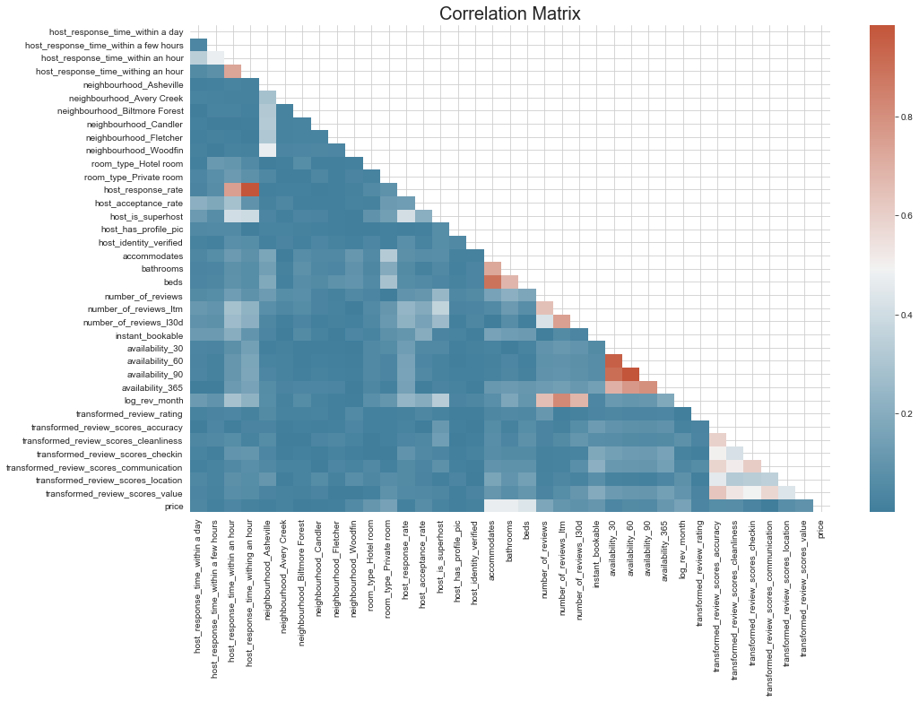
a summary of the data-analysis process. HYPOTHESIS 4
The dataset contains 6 review components: location, accuracy, cleanliness, checkin, communication and location
A correlation matrix has been plotted to visualize relations of variables with the price;
Some of variables have been transformed to make distributions close to normal;
Strong relation with the price have number of bathrooms, number of people could room accommodates, number of beds, number of reviews and number of reviews per month
All of the review components have weak correlation with a price <0.1
Test on normality
Test on homogeneity (ratio =1.33<2)
ANOVA test
Room types have a statistically significant effect on the price with the large F-statistic=425 and p-value = 0 < significance level = 0.05.

Slide 12
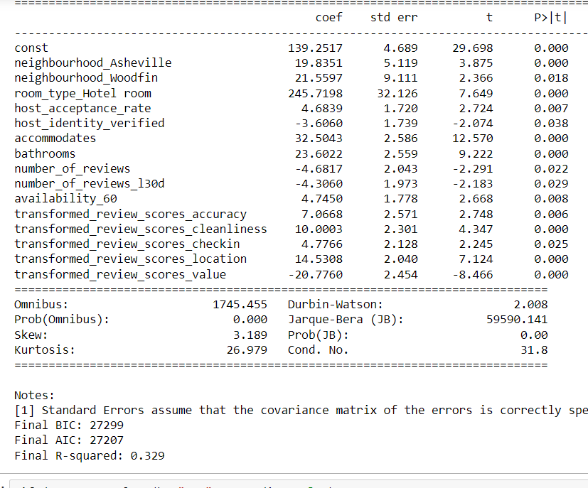
a summary of the data-analysis process. HYPOTHESIS 4
Method to test hypothesis: Ordinary Least Squares (linear regression)
To choose features there has been used backward elimination function to check these terms:
P-value < 0.05
VIF{variation inflation factor} <5
Statistic output after applying linear regression method:
5 of 6 components of review are statistically significantly affect
the price (accuracy, cleanliness, checkin, location, value)
Test on normality
Test on homogeneity (ratio =1.33<2)
ANOVA test
Room types have a statistically significant effect on the price with the large F-statistic=425 and p-value = 0 < significance level = 0.05.

Slide 13
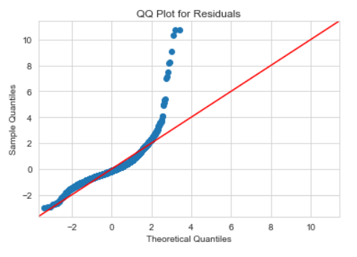
a summary of the data-analysis process. Machine modeling
Linear regression did not show the great results on predicting price: residuals are not lying on the straight line;
Decision Tree and Random Forest models have been implemented
The comparison of these models showed that Random Forest gave poor but the best result;
 | R-squared | Mean Absolute Error | Predicted average price
Linear Regression | 0.278733 | 52.730160 | 154.532856
Decision Tree | -0.080875 | 62.604131 | 152.829604
Random Forest | 0.310624 | 51.569793 | 159.190000
Test on normality
Test on homogeneity (ratio =1.33<2)
ANOVA test
Room types have a statistically significant effect on the price with the large F-statistic=425 and p-value = 0 < significance level = 0.05.

Slide 14
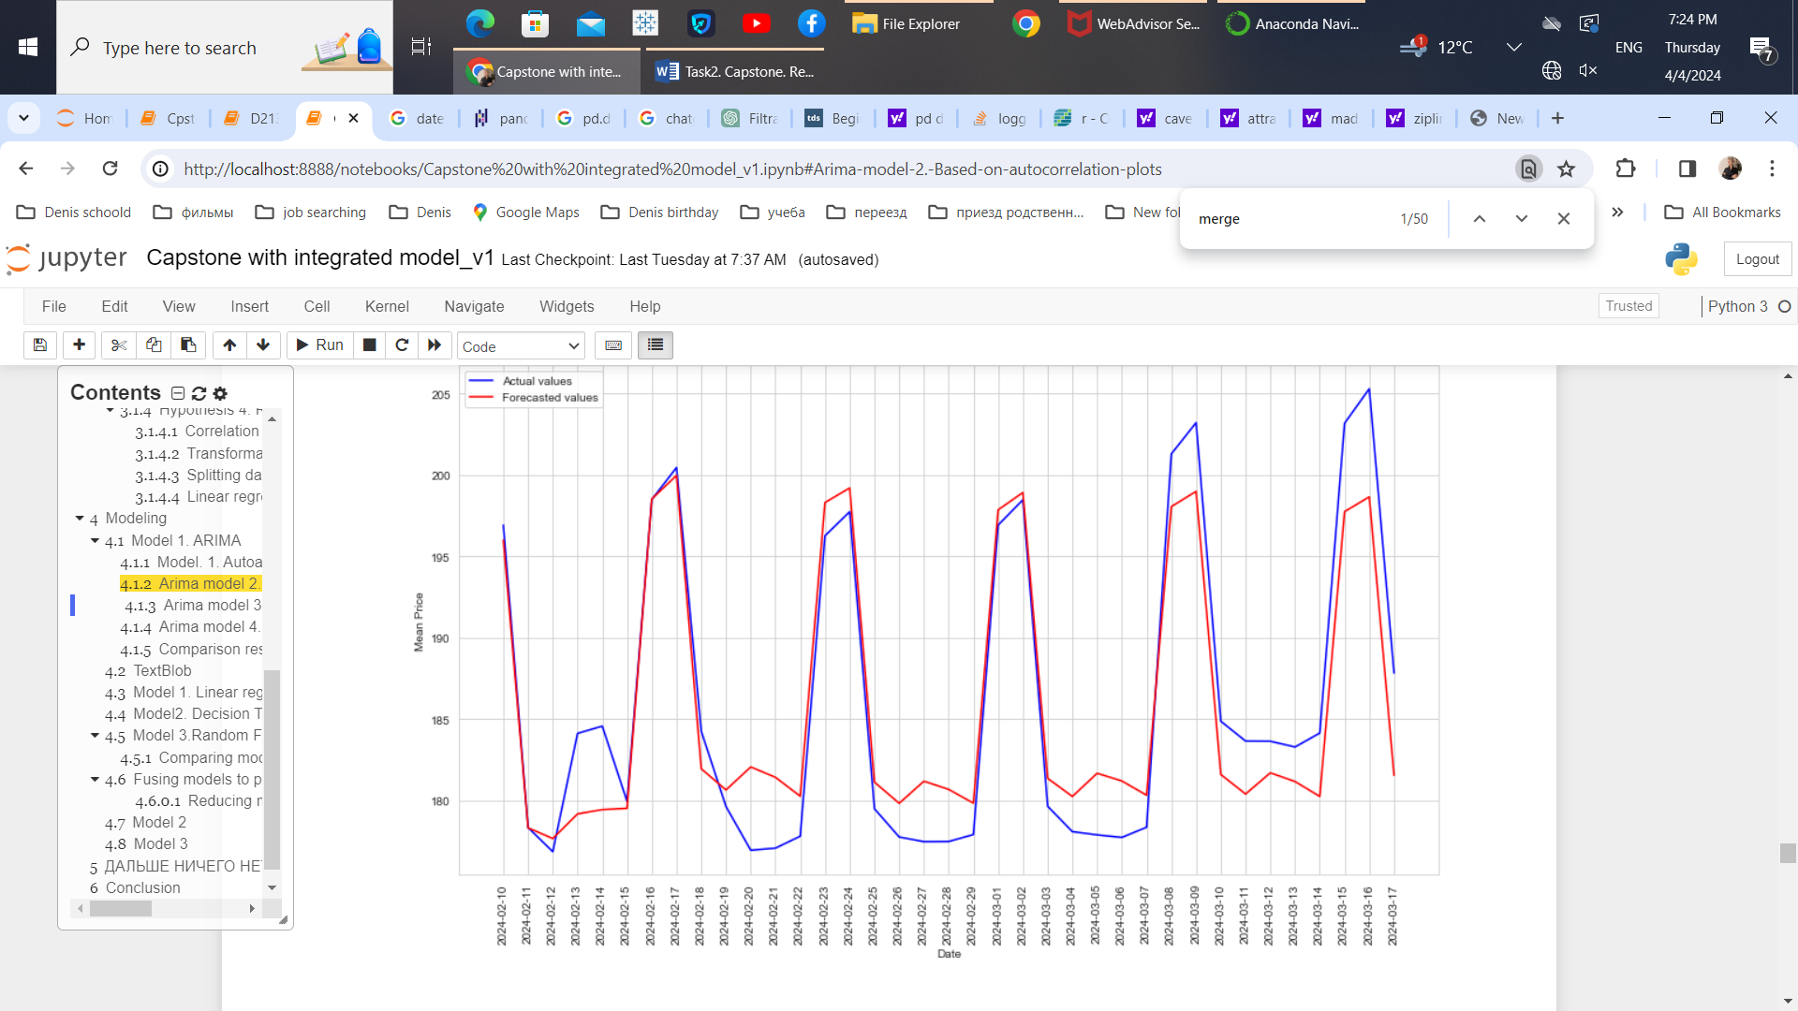
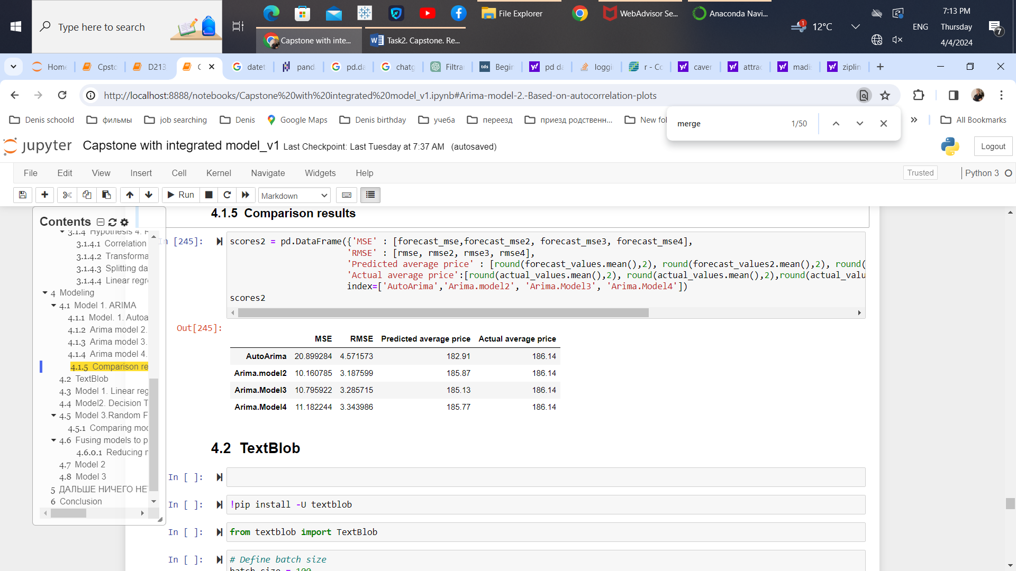
a summary of the data-analysis process. Machine modeling
To predict a dynamically changing future prices, ARIMA model has been used;
To choose the best model there have been compared results of autoarima model and models built with different {pdq} combinations, based on pacf and acf plots
Best model is a model 2, with {pqd} = 8,1,23
Test on normality
Test on homogeneity (ratio =1.33<2)
ANOVA test
Room types have a statistically significant effect on the price with the large F-statistic=425 and p-value = 0 < significance level = 0.05.

Slide 15
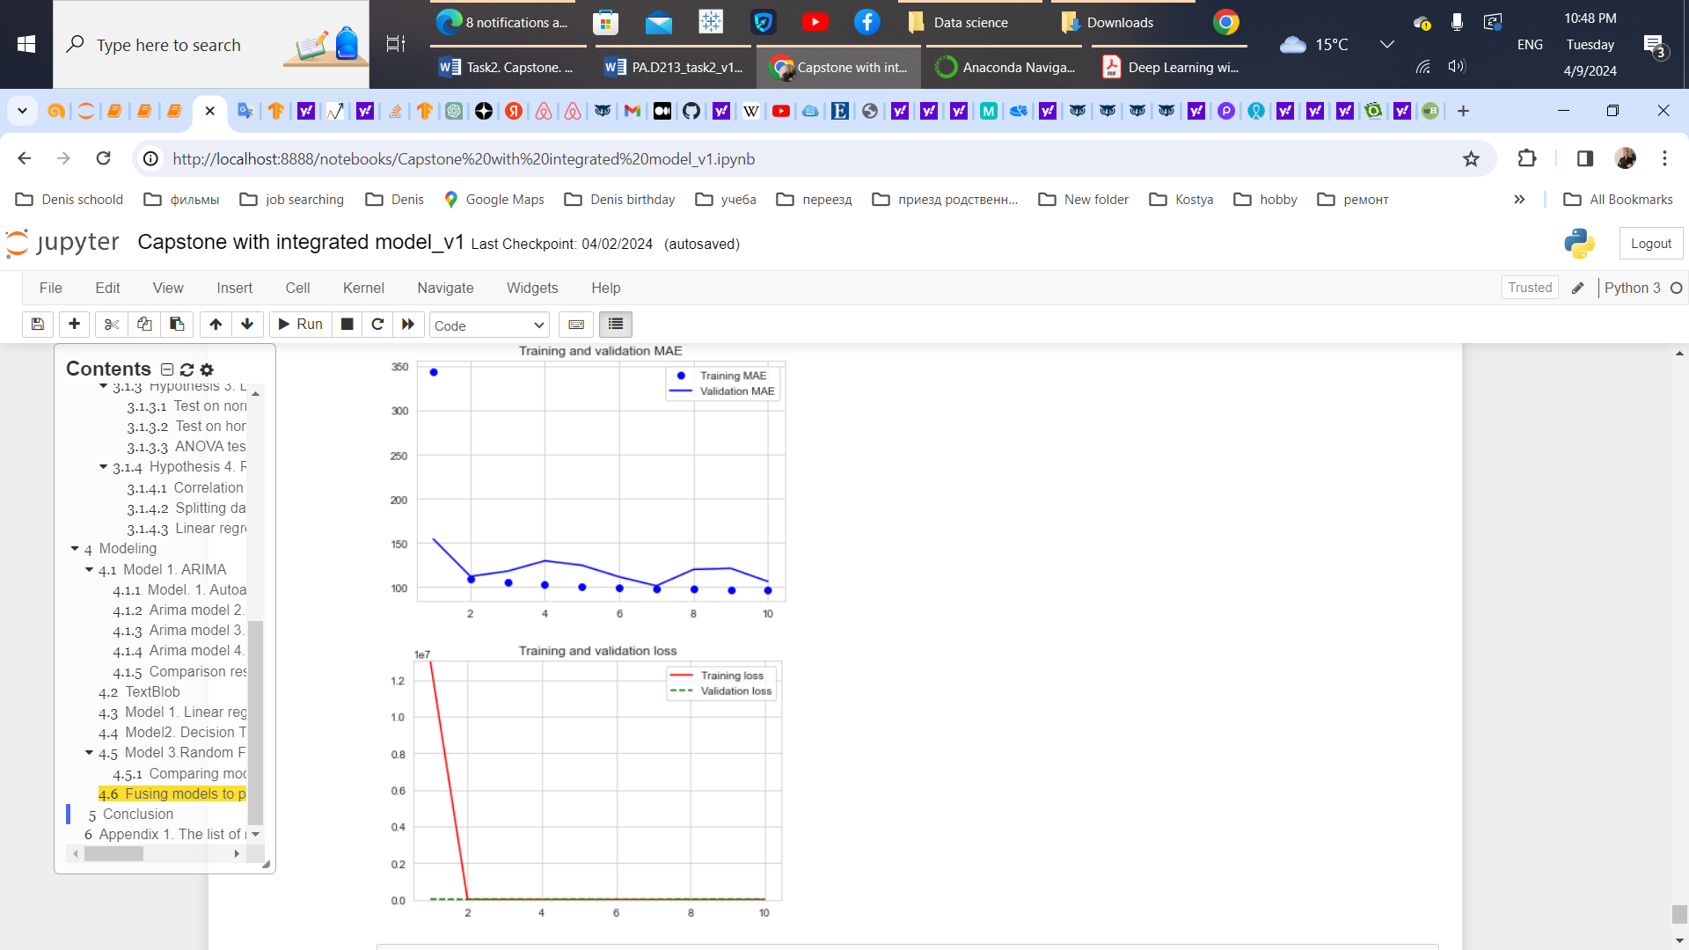
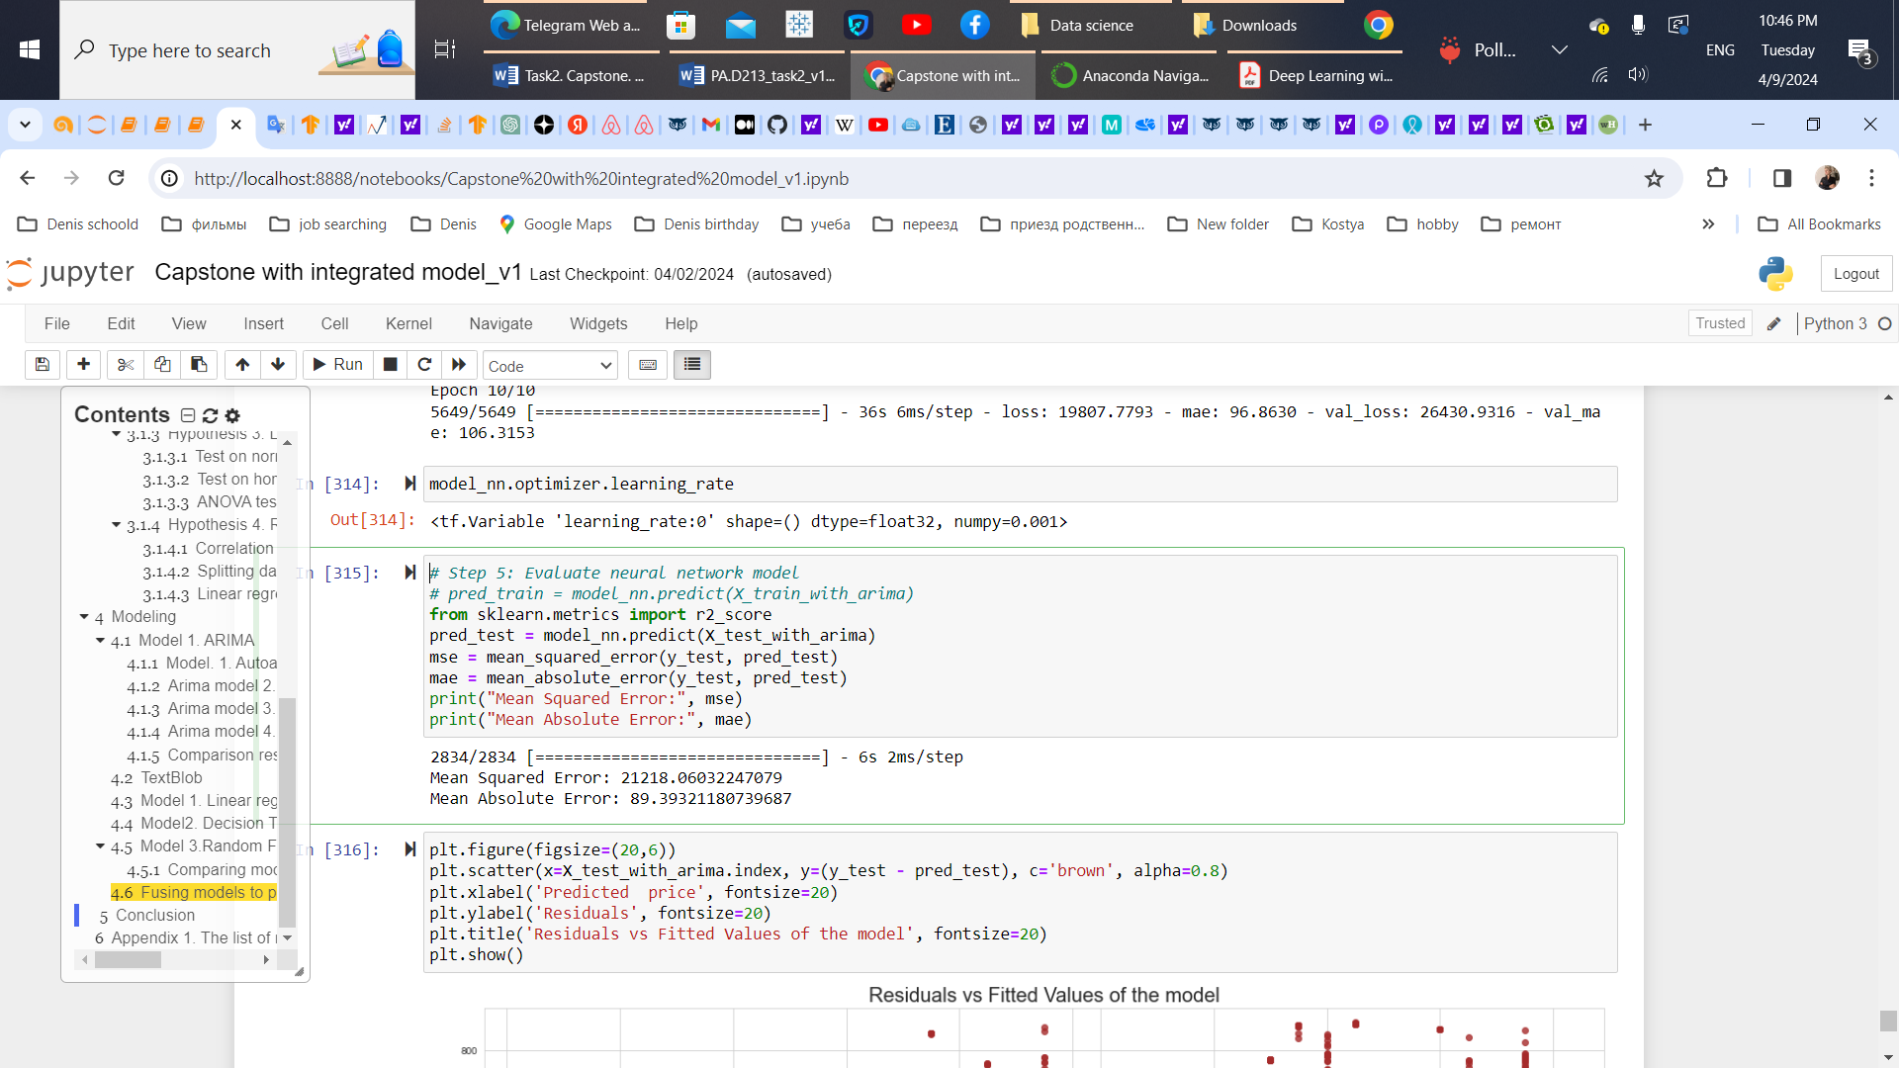
a summary of the data-analysis process. Fusing models
The main idea – integrating the ARIMA predictions into a machine learning model;
Architecture of chosen NN:
1st layer: Core_type = Dense
Layer_type= Input
Number of parameters = 28160
2nd layer: Core_type = Dropout
Layer_type = Dropout
Number of parameters = 0
3^{d} layer: Core_type = Dense
Layer_type= Hidden
Number of parameters = 131328
4th layer: Core_type =Dropout
Layer_type= Dropout
Number of parameters = 0
5th layer: Core_type =Dense
Layer_type= Output
Number of parameters = 257
POOR RESULTS
Test on normality
Test on homogeneity (ratio =1.33<2)
ANOVA test
Room types have a statistically significant effect on the price with the large F-statistic=425 and p-value = 0 < significance level = 0.05.

Slide 16

AN EXPLANATION OF THE LIMITATIONS OF THE TECHNIQUES AND TOOLS USED
Linear relationships between variables (for ANOVA and linear regression);
Unspecified patterns and dependencies in the data, particularly if complex seasonal variations exist;
Existing additional relevant features that could influence listing prices, leading to potential omitted variable bias;
Time-consuming preprocessing steps;
The technical constraints that impact modeling phases of this study (machine capacities)
Test on normality
Test on homogeneity (ratio =1.33<2)
ANOVA test
Room types have a statistically significant effect on the price with the large F-statistic=425 and p-value = 0 < significance level = 0.05.

Slide 17
A SUMMARY OF PROPOSED ACTIONS
Train the model on a larger dataset, spanning multiple years;
Includes information from other areas within one South-Eastern region;
Expanding dataset with additional factors
-economic factors: taxes, fees;
- host experience (a number of months since the hosts joined AIRBNB and the amount of listings they have)
property characteristics and specific amenities, which potentially could influence the price, such as pools, hot tubs, pool tables, coffee machines, etc.
Improving architecture of the model (incorporating LSTM (Long-short-term memory) layer and the GRU (gated recurrent unit) layer with using recurrent dropout arguments of the recurrent layers.)

Slide 18
EXPECTED BENEFITS OF THE STUDY
Improved understanding of what factors are major components in the price-making process helps increasing guest’s emotional and cognitive well-being;
Enhanced dynamic pricing enables hosts to capitalize on peak demand periods by raising prices, and opposite, decreasing booking prices on low-demand periods to stimulate bookings;
Outliers could stimulate appearing of potential ideas and open a new niche for business (example, partnerships);
The study could be further reinforced by applying a new ML algorithms and methods and potentially enhanced the model to be used not only in the area of short-term rentals but across broader real estate;

Slide 19
THANK YOU!

